Slide 1
Digestion of carbohydrate
By
Ram Balak Mahto
Guest faculty
Zoology department
V.S.J College Rajnagar Madhubani

Slide 2
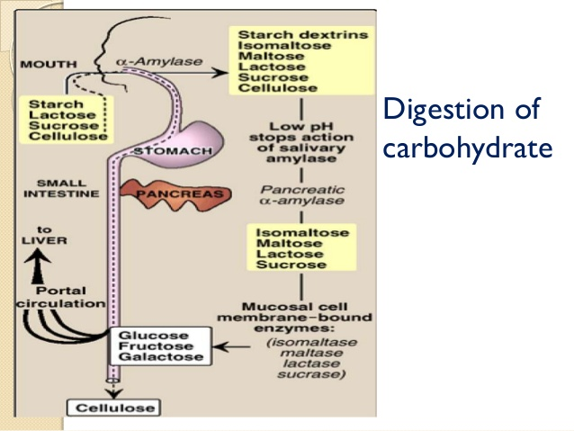
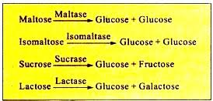
Digestion of carbohydrate

Slide 3
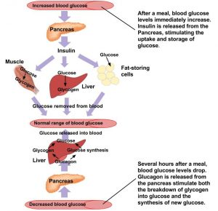
Level of glucose in the blood is maintained

Slide 4
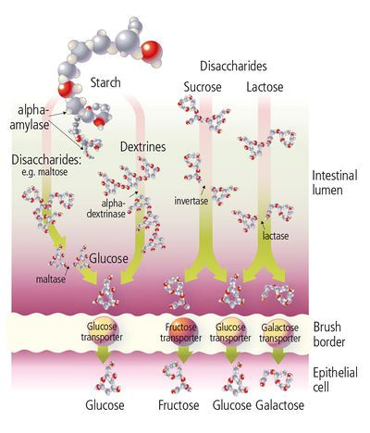

Slide 5
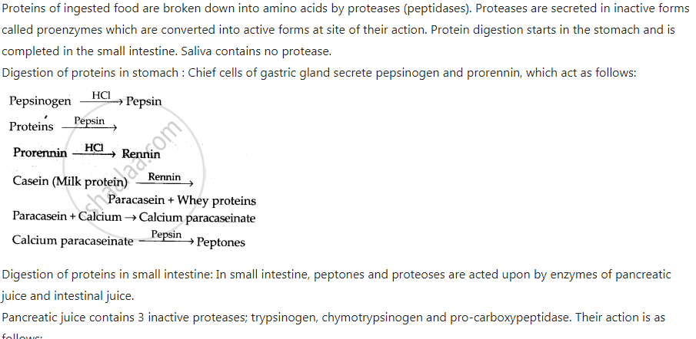
Digestion of protein

Slide 6
